Slide 1
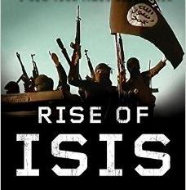
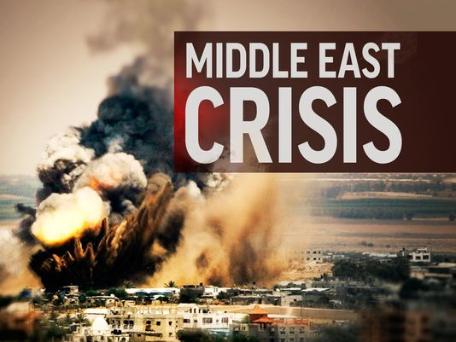
Islamic State- Rise & Implications
Compiled by:Pratik Nayak
Mrunal.org

Slide 2
Background
Islamic State of Iraq and Syria (ISIS) aka Islamic State(IS) aka Islamic state of Iraq and Al Shams aka Islamic State of Iraq & Levant(ISIL) aka DAESH (al-Dawla al-Islamiya fi al-Iraq wa al-Sham)
ISIS follows Sunni Sect of Islam.
In Sunni→ Salafi Sect, wants to implement shariat law
Shia-Sunni Conflict
Iraq→ Shia Majority, Used to be ruled by Sunni Ruler- Saddam Hussein
Syria→ Kind of Sunni Majority, Still ruled by Shia Ruler- Bashar al Assad
Mrunal.org

Slide 3
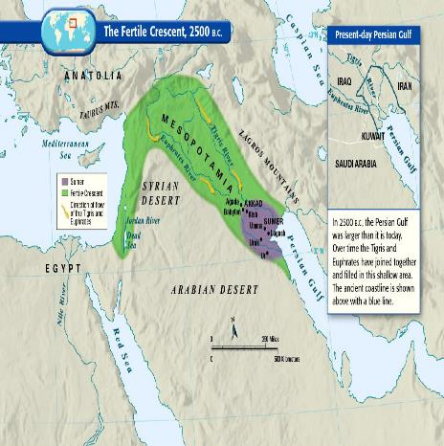
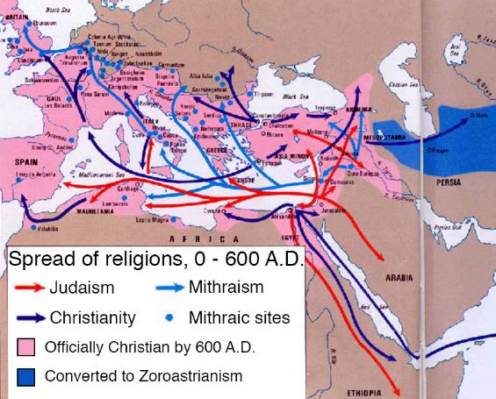
History
Fertile crescent, the cradle of civilization
Called "the fertile crescent" because of its lush soil, the "crescent" of land mostly includes modern-day Iraq, Syria, Jordan, and Israel-Palestine.
Middle East gave Europe religion, three times
Mrunal.org

Slide 4
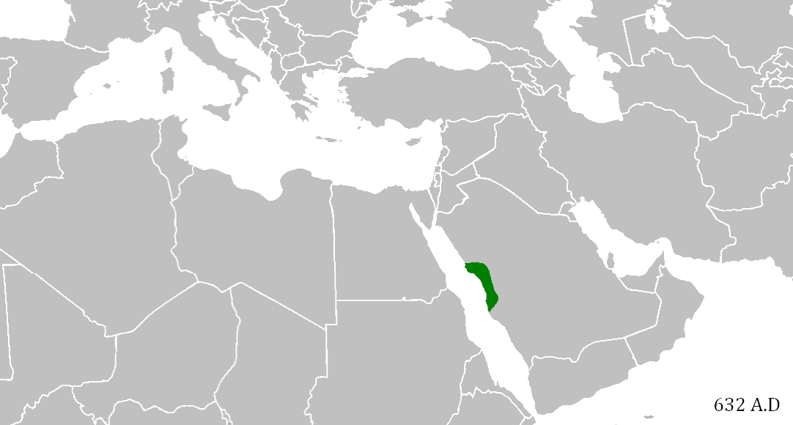
History
In the early 7th century AD in present-day Saudi Arabia, the Prophet Mohammed founded Islam
Prophet Mohammed's Caliphate conquered the Middle East
Mrunal.org

Slide 5
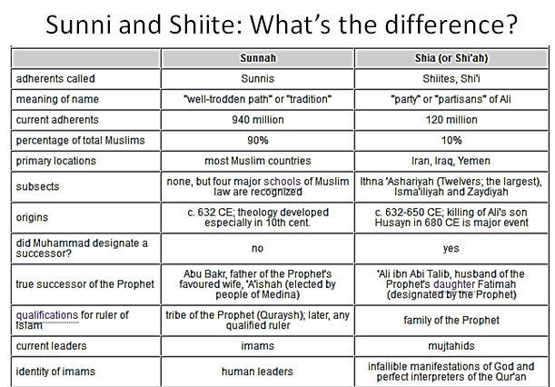
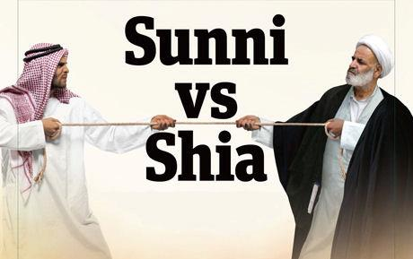
Schism and fight for Successor
Prophet Mohammed died in 7th century AD
Dispute over who should succeed him in ruling the vast Caliphate
Shia
Sunni
Some wanted to elect a successor, while some argued power should go by divine birthright to Mohammed's son-in-law, Ali
Dispute became a civil war
Ali Killed in iraq near Kufa
20 years later- Ali’s son hussein travelled with his followers from mecca to karbala, where a battle took place and he was kiied
For Shia Muslims main Pilgrimage- Kufa and Karbala
The Battle of Karbala, 680 AD
Mrunal.org

Slide 6
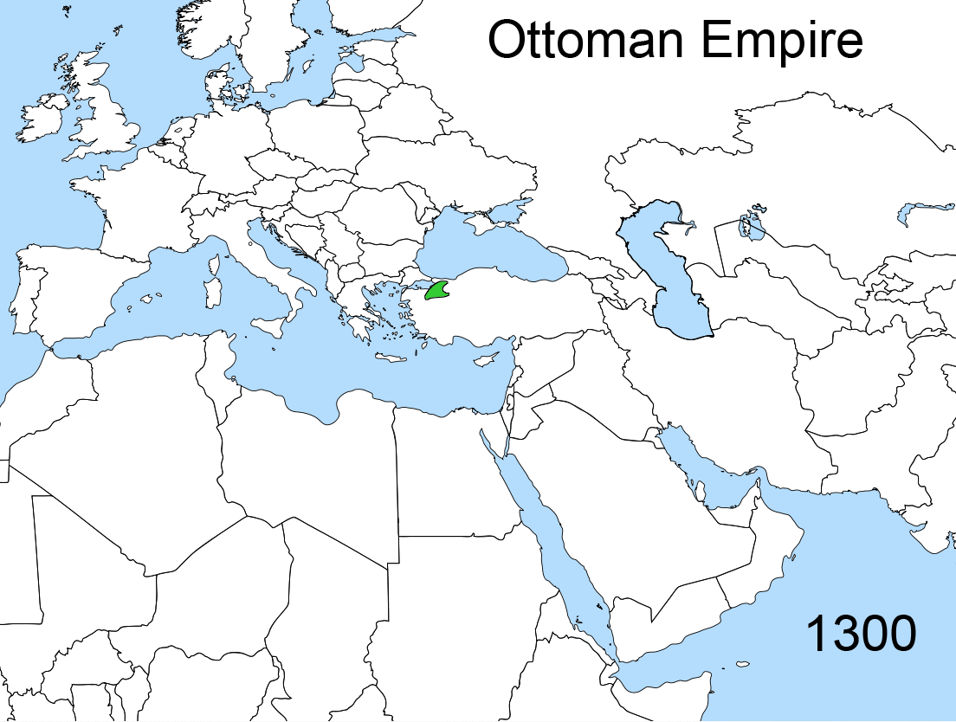
Ottoman Empire
Rise & fall of the Ottoman Empire
Khalifa-Sunni
The Ottoman Empire is named for Osman, its first ruler, in the early 1300s expanded it from a tiny part of northwest Turkey to huge empire
Mrunal.org

Slide 7
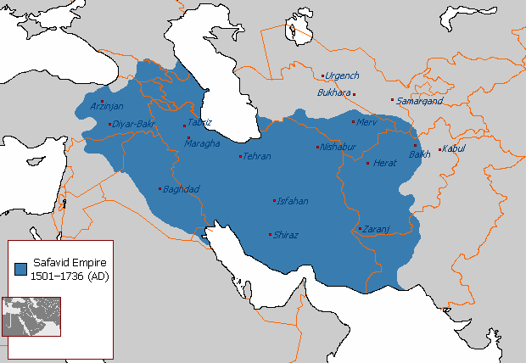
Safavid Empire
The Safavid Empire also known as Persian Empire
Safavids→ Shia
Constant Fighting between Safavids and Ottoman
Mrunal.org

Slide 8
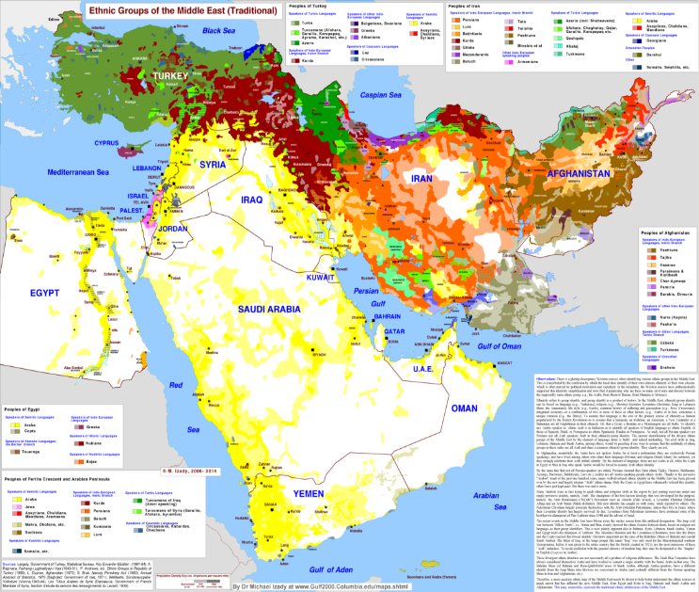
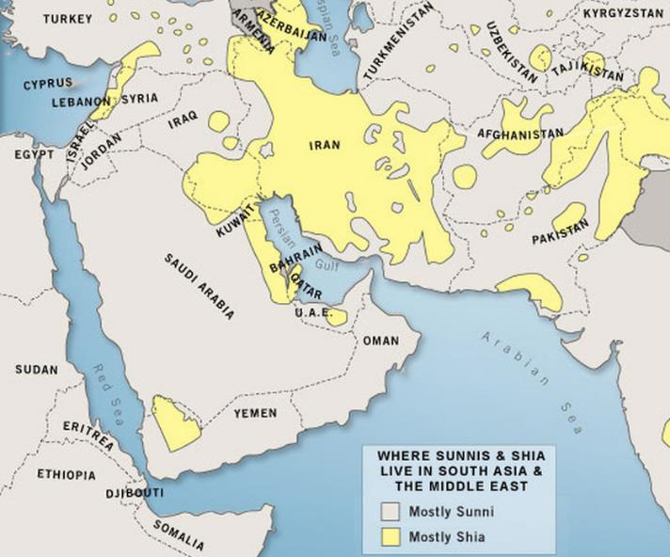
Understanding Middle East
Demography and Religion
Ethnicity
Mrunal.org

Slide 9
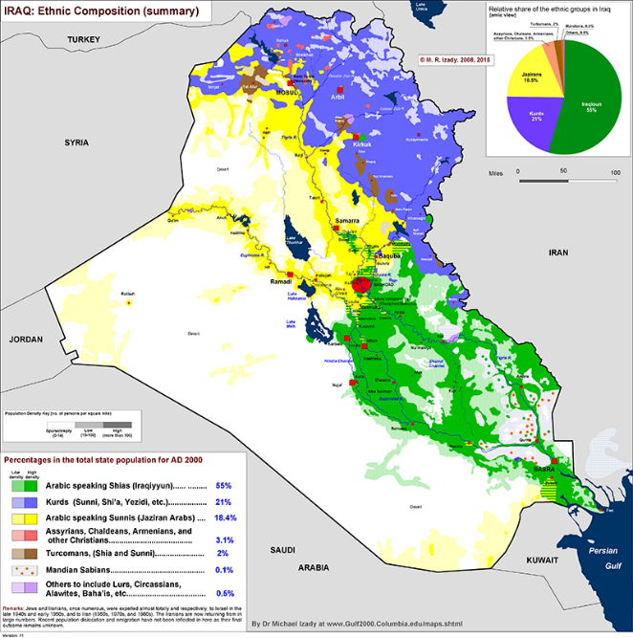
Understanding Iraq
Three-way demographic divide
Shia Arabs- Lives in South
Sunni Arabs- lives in north and west
Ethnic Kurds, who are religiously Sunni, but their ethnicity divides them from Arab Sunnis.
Mrunal.org

Slide 10
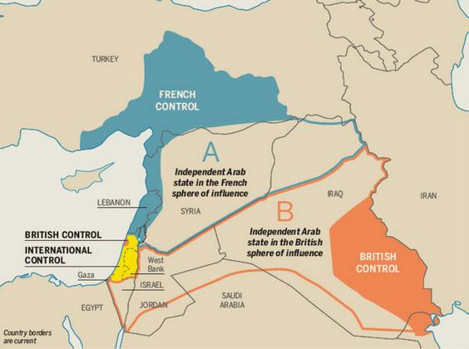
Fall of Ottoman Empire- Sykes Picot Agreement
Mandate System- League of Nations
Iraq→ UK
Syria→France
1916 treaty, in which the UK and French (and Russian) Empires secretly agreed to divide up the Ottoman Empire's last Mid-Eastern regions among themselves.
Mrunal.org

Slide 11
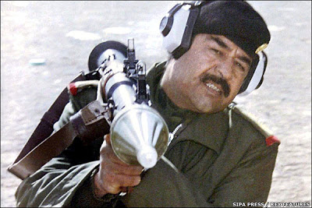
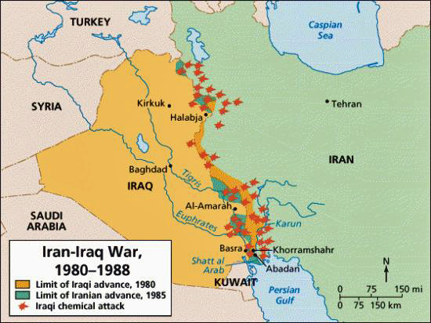
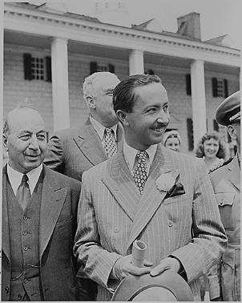
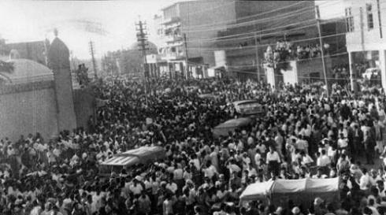
Iraq History – Rise of Saddam
1920 to 1932- British Occupancy
1932-1958 -Hashemite monarchy
1958-1969 InBetween turmoil time
Military government of Abd al-Karim Qasem and the "Free Officers" (1958–1963);
First regime of the Ba'ath Arab Socialist Party (February–November 1963);
Governments of the Arif brothers and Abd al-Rahman al-Bazzaz (1963–1968).
Second Ba‘th regime began with Coup
Saddam Hussein taking on Presidency in 1979
1980-1988 Iran- Iraq War
Mrunal.org

Slide 12
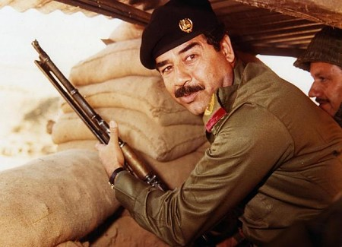
Reign of Terror for Shia and Kurds
Kurds —long-oppressed minorities in Iraq, Syria, Turkey, and Iran
Now fighting for de facto autonomy
1988,Saddam Hussein's Al-Anfal campaign against the Kurds killed 15000 people
Genocide is most infamous for use of chemical weapons
Mrunal.org

Slide 13
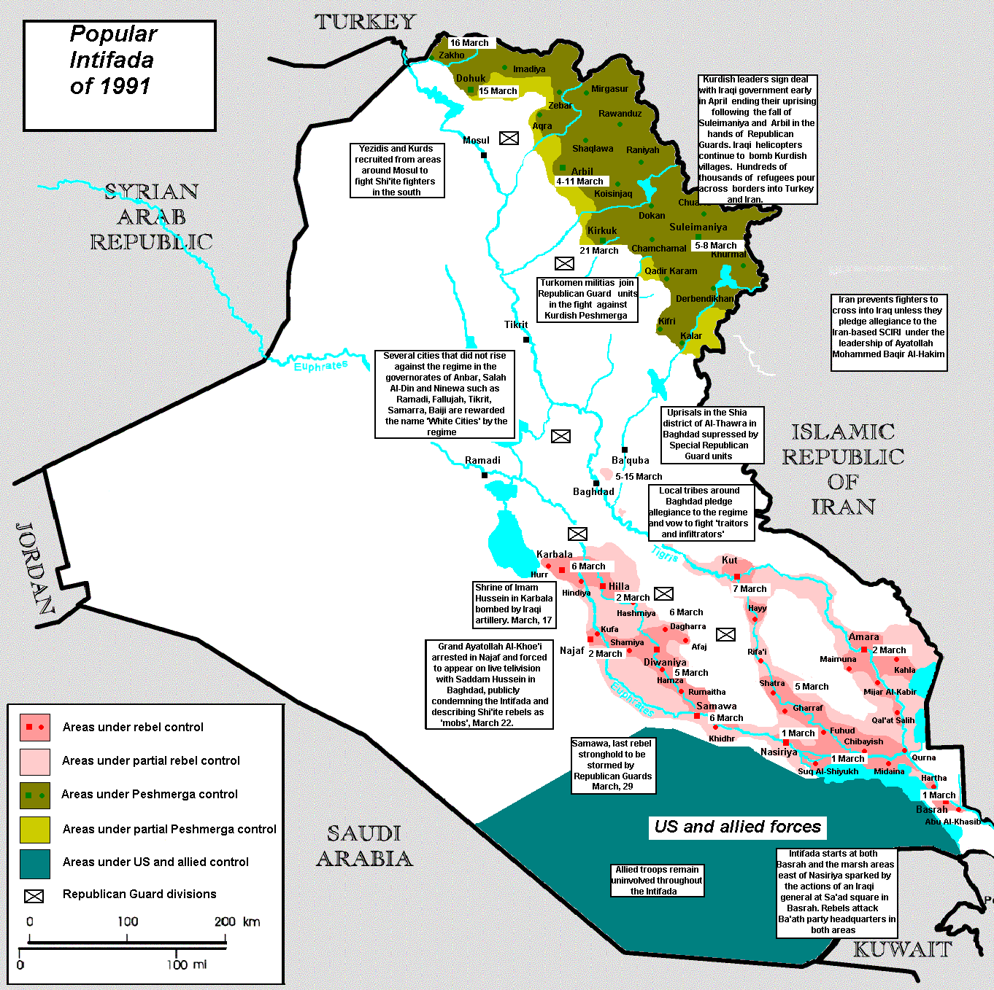
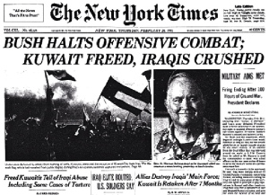
Reign of Terror for Shia and Kurds
1990 Gulf War
Iraq invaded its neighbor Kuwait following disputes about oil production, and installed a puppet regime to run the country
Feb 1991 End of war- Iraqi forces retreated under attack from US and Saudi Coalation
Anti Saddam Uprising
March 1991, anti-Saddam uprisings
Kurdish rebels in the north and Shia Islamists in the south rose up in rebellion
within a few weeks Saddam had defeated them and slaughtered thousands in reprisal killings
Mrunal.org

Slide 14
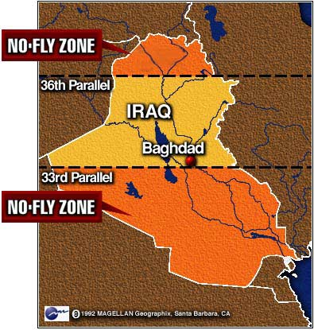
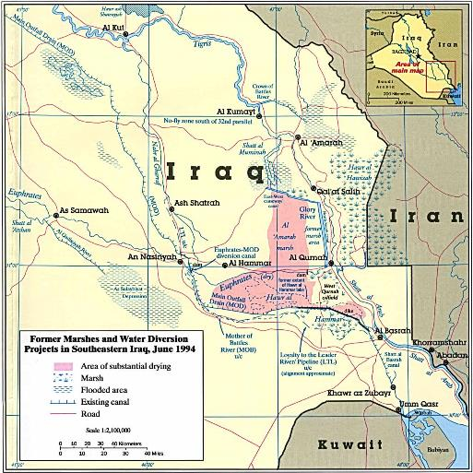
Reign of Terror for Shia and Kurds
US Sanctions post gulf war
Draining of Marshes
To capture rebels
Mrunal.org

Slide 15
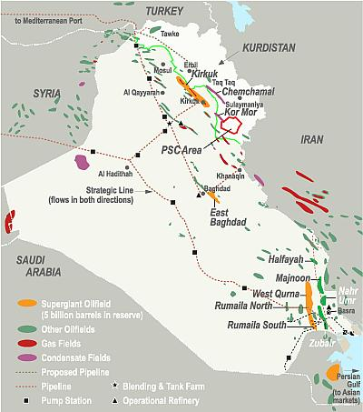
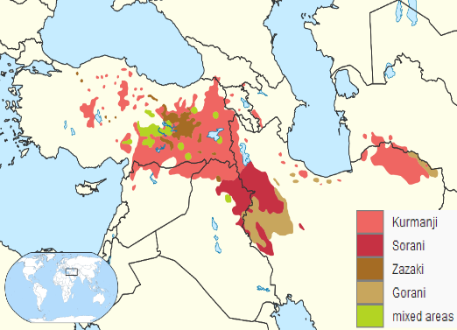
Oil Reserves
Iraq has the fifth largest proven oil reserves of any country, after Venezuela, Saudi Arabia, Canada, and Iran
Oil is concentrated in the Shia south and Kurdish north, with Sunni regions to the west notably lacking in oil wealth
Significance- Sunni ISIS rebels have targeted the country's largest oil refinery
Mrunal.org

Slide 16
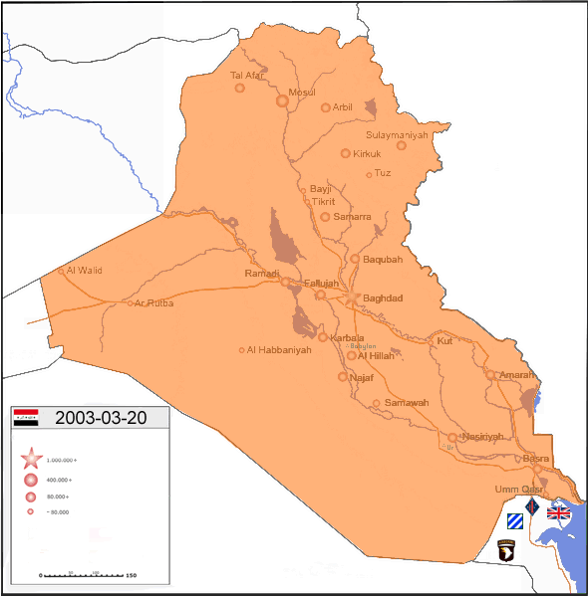
US Invasion of 2003
Mrunal.org
De-Baathification of Iraqi Army & Government
The purpose of which was to cleanse the government of any influence from former members of Saddam's Baath Party so the past regime don’t reassert itself after its toppling
Problem with this plan is that a large number of recently unemployed Iraqi soldiers went and joined insurgent militias
Mrunal.org

Slide 17
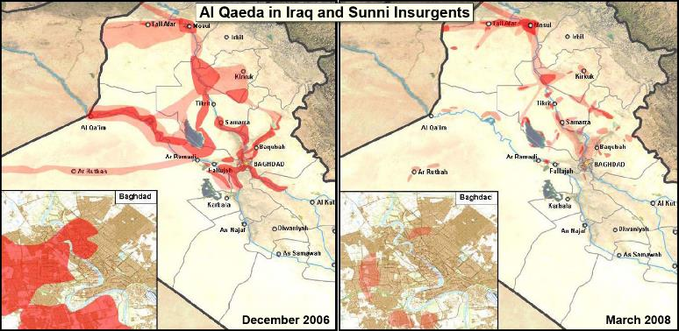
Insurgency on the rise
ISIS was formerly known as al-Qaeda in Iraq (AQI)
In 2006, AQI controlled significant chunks of Sunni Iraq
Also set up a quasi-government along harsh Islamic lines
former Sunni insurgents partnering with the American and Iraqi militaries to uproot AQI
Anbar Awakening
By 2008
fall of AQI
Mrunal.org

Slide 18
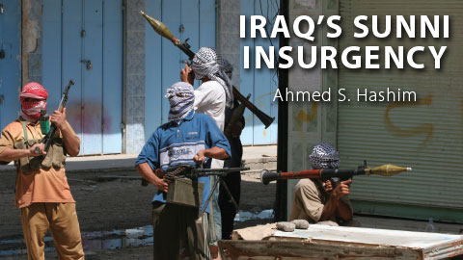
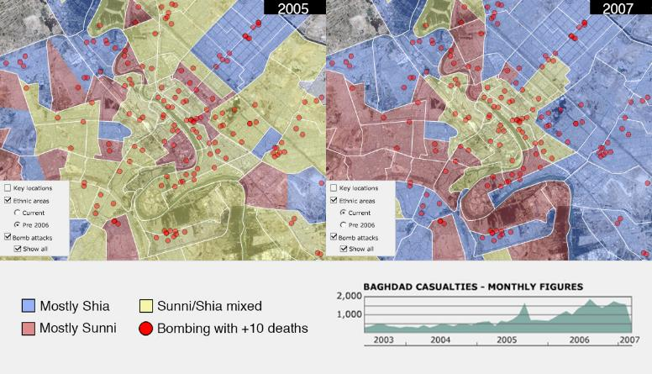
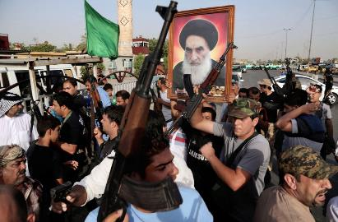
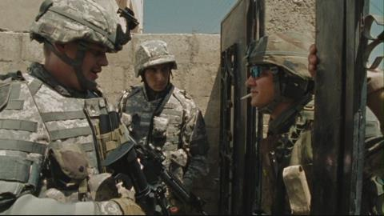
Civil War and Ethnic Cleansing of Baghdad
Shia Militias
Sunni Insurgents
US led Forces
Civil War
Mrunal.org

Slide 19
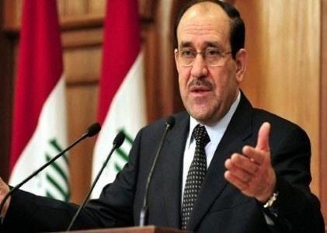
Role of the New Government
1st PM Nouri al Maliki
Came to power in 2006
Tripartite Agreement- New Constitution
Prime Minister (Shia)
President (Kurd)
Speaker (Sunni)
Did a lot to assist in ISIS's rise
Centralized a great deal of power in his office
Ran the Iraqi government along Shia sectarian lines
Mrunal.org

Slide 20
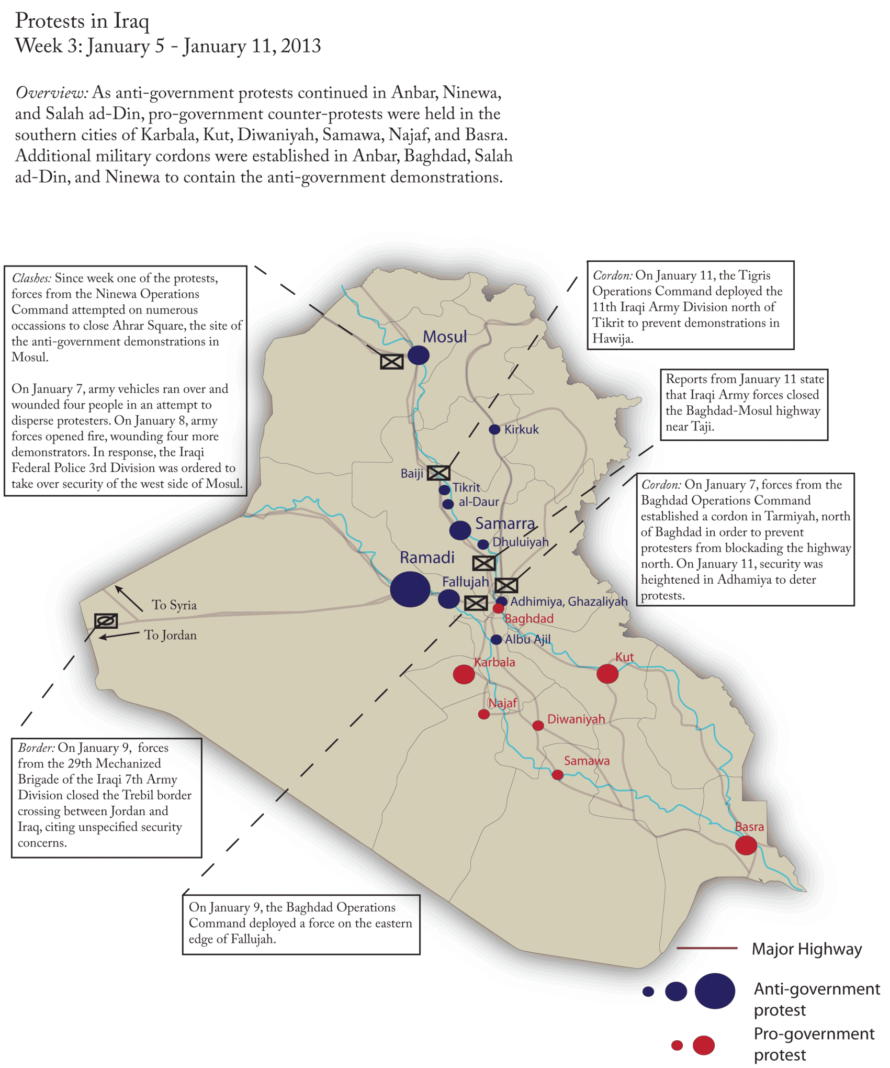
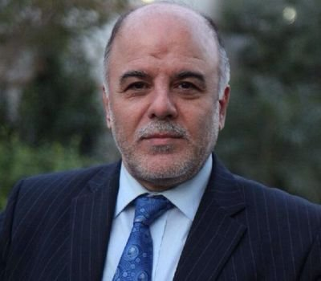
Protest Movement
Infuriation of Sunnis→Maliki government began to see them as a serious problem, turned to use of force for forcible breakup of the protest movement
This convinced some Sunnis that their only solution was military, and started helping militant groups like ISIS
Sept 2014, Nouri Al Maliki Steps Down
New PM Haider al-Abadi takes charge
Mrunal.org

Slide 21
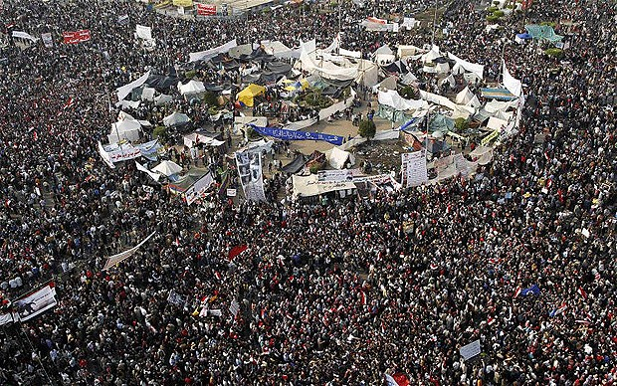
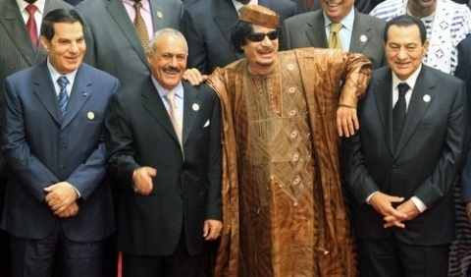
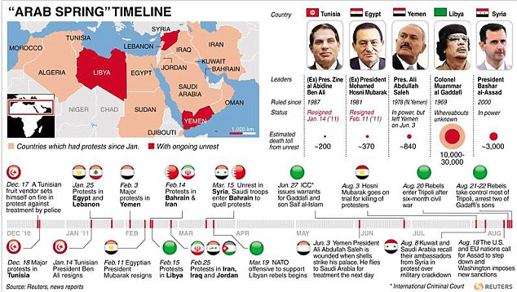
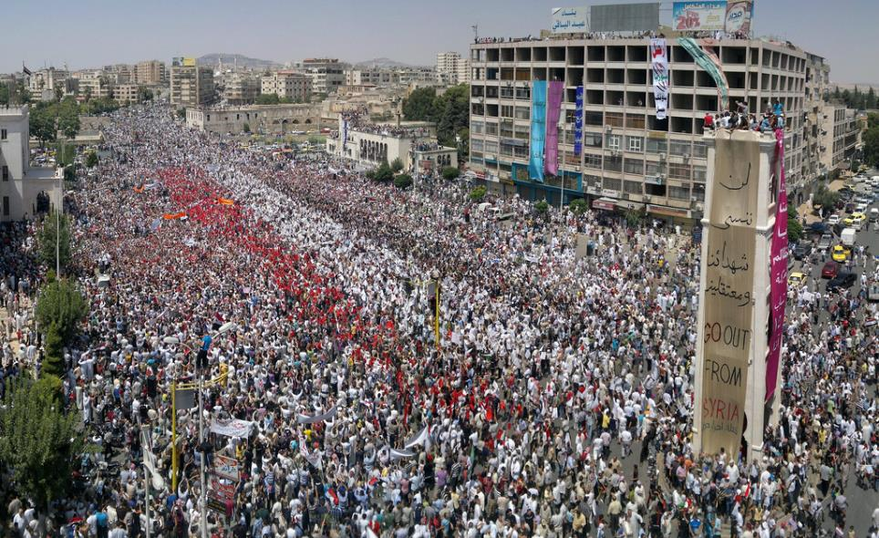
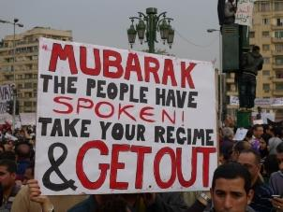
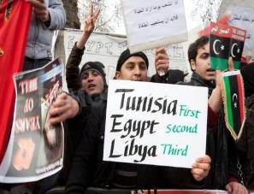
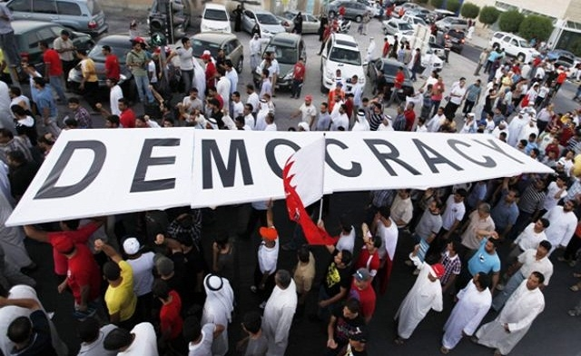
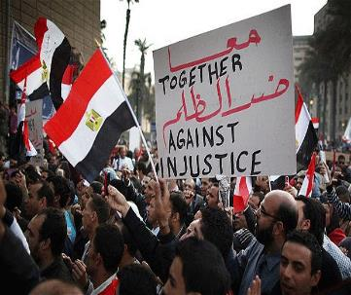
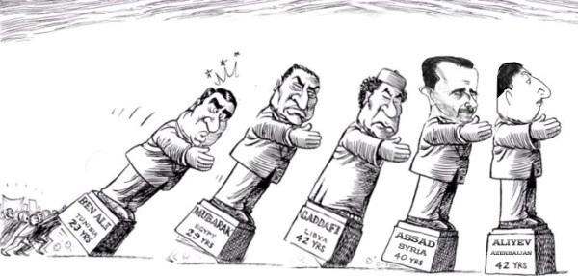

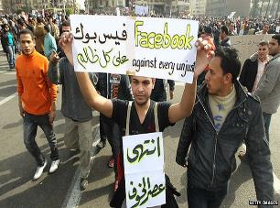
Background- Parallel Developments in Arab Countries
Tahrir Square 2011
Damascus 2011
Mrunal.org

Slide 22
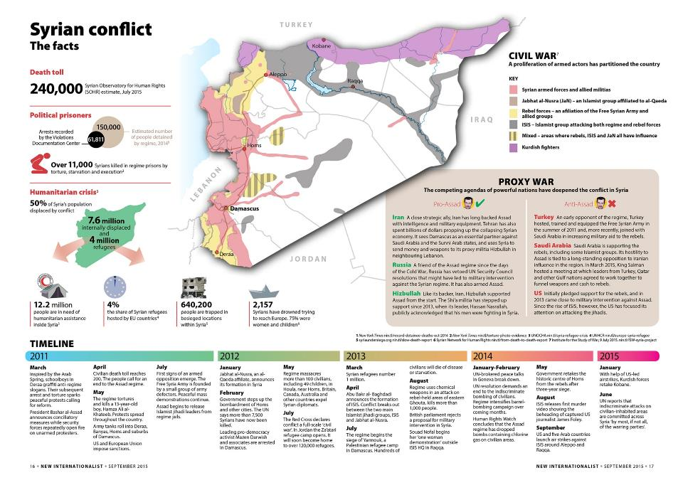
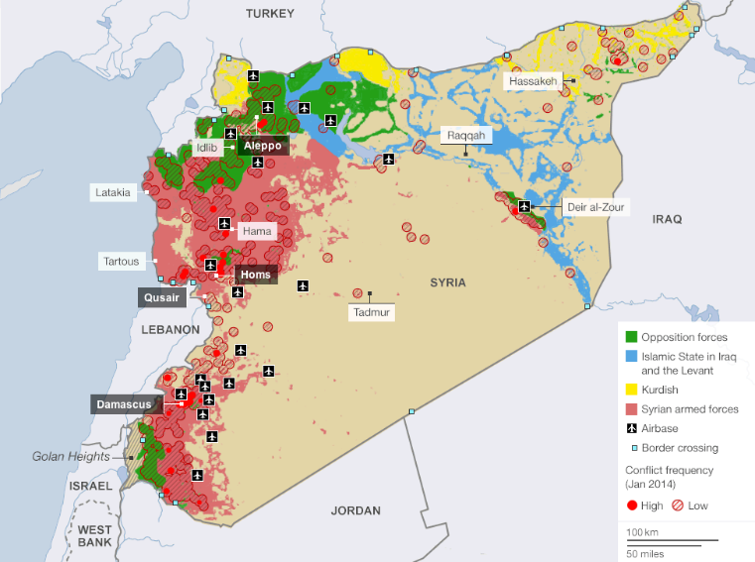
Rise of ISIS and Syria's civil war
Crucial for understanding the Iraq crisis because ISIS spent a year fighting and winning territory in Syria before it opened its offensive in Iraq
Mrunal.org

Slide 23
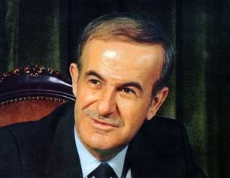
Rise of ISIS and Syria's civil war
1923–1946: French imperialism(Sykes Picot Agreement)- Sectarianism Promoted (Shia-Sunni)
Minority group, Alawite Shia Muslims partnered with French-newly constructed Syrian military
1963, Indirect French Control got over- The Syrian military took power, and the government quickly became dominated by Alawites
Hafez al-Assad (Shia) came to power in 1970
Sunni majority was blocked from meaningful political power
Syrian forces intervene in Lebanon's civil war, on behalf of Lebanese Christian groups who were fighting Muslim groups
Mrunal.org

Slide 24
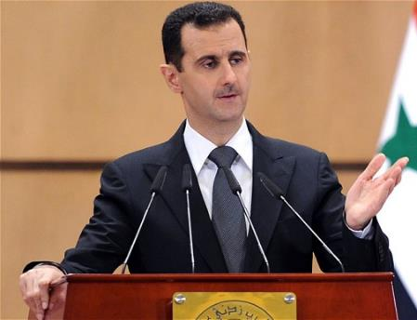
Rise of ISIS and Syria's civil war
1980s & 90s, opposition was strongest, slaughtering thousands of civilians
In 2000 his son Bashar al-Assad came to power and continued despotic and sectarian rule
Mrunal.org

Slide 25
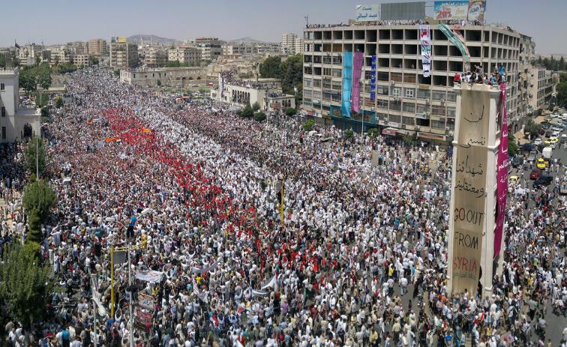
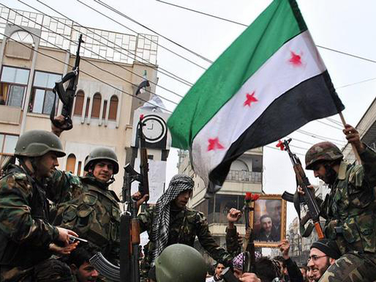
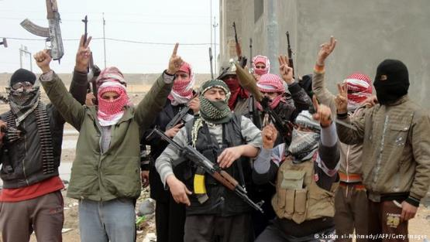
Rise of ISIS and Syria's civil war
March 2011: Arab Spring, Protests in Damascus
July 2011: The Free Syrian Army is Founded - Supported by USA to topple Assad’s regime
August 2011: An Iraqi group arrives in Syria — and later becomes ISIS
AQI leader Abu Bakr al-Baghdadi sent a top deputy, Abu Mohammad al-Joulani, to Syria
Joulani succeeded, establishing Jabhat al-Nusra
October 2011: In the wake of Libya, Russia vetoes a UN Security Council resolution condemning Assad
Mrunal.org

Slide 26


Rise of ISIS and Syria's civil war
January 2012: The creation of Jabhat al-Nusra- often attributed to Assad as initially released thousands of sunni extremists prisoners from jail.
Assad hoped to unite the Syrian Christians & Alwaite Shia Muslims to fight against Sunni extremists
Currently Jabhat al-Nusra is fighting against IS & also the regime for territorial control
Mid- to late 2012: Hezbollah invades Syria, giving help to syria by fighting anti assad terrorists- a show of Iran's new role
March 2013: The Arab League endorses arming the rebels
April 2013: The birth of ISIS
What essentially started as anti regime movement has converted into sectarian, multilateral country supported hotpotch
Mrunal.org

Slide 27




Reasons for rise of ISIS
Role of Maliki government, Civil war in Iraq ( Shia, Sunni) and Civil war in Syria
Withdrawal of western troops from Iraq in 2009
Death of Osama Bin Laden
US war on terror reduced al Qaeda to a weak force due to constant bombing, whereas ISIS areas still considered a safe sanctuary
Mrunal.org

Slide 28




Reasons for rise of ISIS
Unlike al Qaeda which doesn't wants a state, they only target whereas ISIS has established a caliphate with proper state Raqqa (Syria)- Capital of IS Proper State Administration, Electricity, Schools, Courts etc.
This provides stability to war torn region and people without any political affiliation are tactically accepting IS Besides, Use of Indiscriminate Violence Taxing rich people (Zakat) and non muslims (zaziya) , Imposition of Shariat law
Best funded terror group in the world $2bn collected annually from kidnapping, oil selling in black market and funding from Arab countries
Mrunal.org

Slide 29


ISIS organisational Set up
Many of its leaders are former officers from Saddam Hussein’s army
Mrunal.org

Slide 30



Global Strategy to tackle ISIS
International Conference in Paris( Sep 2014)
Objective- To design a Joint Strategy against IS
Irony→ Nov 2015 Paris Attacked by ISIS
30+ Countries agreeing to join US led coalition against IS
Ariel attacks done by coalition forces Targeting oil wells, storages, pipelines of IS IS announced Global Terror Organisation
But these Ariel attacks not getting desired results, why?
1st- Change in strategy by IS- Do not move by convoys, individual fighters move on motor bikes
Use of camouflaged vehicles, Moved Close to Baghdad & Other Cities
Mrunal.org

Slide 31



Global Strategy to tackle ISIS
But these Ariel attacks not getting desired results, why?
2nd Major Countries Turkey and Iran didn't joined coalition initially. Why?
Kurdish population in Turkey in large proportion.
They want Independence from turkey and get support from Kurdish people based in Iraq.
IS wants to control areas of Kurdistan as well.
So , IS can solve the Kurdish problem for turkey as well. (Recently, Turkey has started bombing IS sites on its border)
US didn't involved ground troops in this attack, only gave training and guidance to Iraqi Army.
US doesn't wants Iran to be a part of coalition and on the other hand Iran is playing major role in strengthening the shia power in Iraq.
Mrunal.org

Slide 32


Area under Control
Mrunal.org

Slide 33


Major Influence zone of IS
Mrunal.org

Slide 34




Implications and policy options for India
More than 7 million Indians live and work in the Gulf region, which is the most volatile region of the world
Their safety and welfare is of overriding importance
India is dependent for over 70% of its oil and gas supplies on the Gulf region
The Gulf region is also India largest trade partner by far - $181 billion in 2012-13
Mrunal.org

Slide 35


Implications and policy options for India
Disruption of normalcy in the GCC countries may result in hundreds of thousands of Indians needing to be rescued
An absolutely massive spike in oil prices leading to a cascading effect sharply increasing prices of items of daily life
Increasing our the current account deficit, disrupting our trade balance even more, doing without huge remittances on which the welfare of some 35 million people is dependent
Finally weakening the rupee
Mrunal.org

Slide 36


Implications and policy options for India
40 Indian workers were kidnapped by the suspected ISIS militants from Mosul during mid-June 2014
46 Indian nurses where taken by ISIS militants from the city of Tikrit
The problem is actually taking place in a distant region, it is considered as a “danger far closer home than it appears"
The main objective of ISIS is to create an Islamic state of which India would also be a part-Khurasan Province
Earliest impacts of ISIS that hit India was the news of 30,000 odd Indian Muslims who reportedly signed up to defend Iraq's holy Shia shrines and fight Sunni Islamist militants in the country
Mrunal.org

Slide 37
Implications and policy options for India
Willingness of the volunteers, who are mainly engineers, students and professionals, raised warning bells for the security agencies in India
The presence of such educated and middle-class Indian Muslims that is posing to be a major challenge while trying to douse the fire that is spreading due to the Middle Eastern crisis
India, which is home to about 180 million (Almost 18 Crores) Muslim population, such acts could trigger untoward sectarian crisis-Shia -Sunni
Mrunal.org

Slide 38
Implications and policy options for India
Intelligence officials warned concerned authorities to plan sensitisation measures as there were reports of a clear division among Shia and Sunni religious leaders on supporting either the Sunni outfit ISIS, or the Shia-dominated al-Maliki government
Demographic nature of the Indian sub-continent where many Muslim youth appear to be dissatisfied and the instant communication that is facilitated by the cyber technology have become key factors for ISIS’s successful penetration in India
Mrunal.org

Slide 39

Implications and policy options for India
Strategy is a function of capability. We are not focusing on events in the Middle East because we have no capability to influence them. Earlier too, people have been kidnapped in the region and we have had to depend on third party negotiators. All global jihad will have India in its crosshairs. We can ignore them only at our own peril
An Indian strategist was of the view that
India’s worst nightmare came into a reality when Abu Bakr al-Baghdadi, during his Ramzan speech(2014), vowed war against several countries, including India
Mrunal.org

Slide 40




Implications and policy options for India
Call of the self-proclaimed Caliph to the Indian Muslims did not go well with most Indian Muslim leaders
Despite their opposition, radicalised Muslims are getting attracted to IS, something that was illustrated by radical Kashmiri youths, who are believed to be deeply indoctrinated by the Deobandi school of thought, seen waving ISIS flags
Q.Radicalisation of the Indian Muslim Youths: The Impact on Internal Security
ISIS, which is very techno savvy unlike other militant groups, has been able to lure young Muslims not only from India, but also from Central Asia and European countries
The group is known for its heavy usage of internet and social media tools
Facebook and Twitter have become the hotspots
Mrunal.org

Slide 41



Implications and policy options for India
Q.Radicalisation of the Indian Muslim Youths: The Impact on Internal Security
Moreover, the ability of the group to convey their messages using a few Indian regional languages, namely, Hindi, Tamil and Urdu as subtitles, make the recruitment process easier
Most of the youths who are believed to be highly radicalised hail from the states of Kerala, Maharashtra, Tamil Nadu, and Jammu and Kashmir
Interestingly, unemployment or poverty is not the only factor attributed to joining the ISIS, but youths with proper educational backgrounds and from middle-income families, are increasingly enticed towards this dreaded phenomenon
Eg. 4 youths from kalyan, strange case of a 26-year-old Adil Fayaz, an Indian student (from Srinagar) in Australia reportedly joined the ISIS in Syria to fight the Assad regime, latest case of DU girl wanted to join ISIS
Mrunal.org

Slide 42
Implications and policy options for India
Most of the youths have been so brainwashed that they left their jobs in India and decided to take up terror path
Q.What needs to be investigated thoroughly is the root cause of the problem that has driven the youths to travel to Iraq and Syria??
1-angle of ideological commitment as a main motive
2-some of the recruits could be joining ISIS for purely mercenary motives
The involvement of a few Indian Muslim youths with the crisis going on in Syria and Iraq is worrying for a few reasons
1st It could set a trend for other like-minded youth who are easily susceptible to radicalisation process
Mrunal.org

Slide 43

Implications and policy options for India
Unconfirmed report of a young suicide bomber of the ISIS, who was from Tamil Nadu, blowing himself up in the Syria-Iraq theatre became a matter of grave concern
If this report is found to be true, it is going to be the first suicide attack by an Indian origin in the world and, it will have a serious repercussion on matters related to India’s internal security
Confirmed report 17 year old NRI from Bharuch
Youngest Suicide Bomber 17 years old
Mrunal.org

Slide 44
Implications and policy options for India
Even if the number of the youths adhered to the ideology of the ISIS might be minuscule, the act of siding with such organisation itself is very dangerous
2nd:How the returnees (from Syria and Iraq), with their first-hand experience of the entire turmoil could easily brainwash their peers at home
Critical issue is the use of the social networking sites and internet-related activities that are fuelling this problem
Paramount concern within Indian security establishment about the use of information technology and other cyber related activities while fanning the ISIS propaganda.
Mrunal.org

Slide 45
Implications and policy options for India
Way Ahead for India:
Establishment of robust intelligence sharing networks with the Persian Gulf countries- already getting result , deportation of youths from UAE
Time has come to look at the Middle East not only from the prism of oil, energy and commercial angle, but from that military-security arena, too
Already-existing military-cooperation between countries such as Oman, Qatar, Kuwait, Saudi Arabia and UAE should be promoted further, where counter-terrorism, intelligence and information-sharing cooperation should be high on the agenda
The possibility of India joining hands with the US-led military attack on ISIS does not seem to be a feasible option
Mrunal.org

Slide 46
Implications and policy options for India
Way Ahead for India:
New Delhi will have to ponder upon the participation in any military strike in a distant country where it has major interests
The safety of the Indians in Iraq as well in other Persian Gulf countries remains a major concern for India
India needs to adopt an inclusive policy in order to tackle the rising radicalisation of Muslim youths in the country
The government and its security establishment needs to build a strong rapport with the larger Muslim society in India, as a majority of them denounce the extremist thought process of organisations such as ISIS
Mrunal.org

Slide 47
Implications and policy options for India
Way Ahead for India:
As a part of the process, a strong channel of communication with the Muslim leaders in different parts of India should be established so as to understand their problems as well as their suggestion
De-radicalisation process of the youths and this itself is an enormous challenge
Finally, a robust cyber surveillance mechanism is the need of the hour
Mrunal.org

Slide 48
Implications and policy options for India
Way Ahead- Foreign Policy
Iraq has been a particularly good and politically supportive friend of India
Iraq is currently the second ranked oil supplier ( july 2014) to India and in the past has periodically been even the top source
India should try and firm up contingency arrangements from now, in advance, for additional supplies from other current suppliers such as Saudi Arabia, Kuwait and the UAE or, even from outside the region, in the event of sudden supply disruptions instead of doing this when or after the disruptions take place
Mrunal.org

Slide 49
Implications and policy options for India
Syria has been a very good and politically supportive friend of India, India has no significant let alone vital national interest stakes in Syria
India should follow the broad principles of its foreign policy, while continuing to call upon all parties to desist from violence and strive to arrive at solutions through negotiations
India should continue to provide humanitarian assistance to internally-displaced people and Syrian refugees in neighbouring countries
India should reiterate that it fully supports efforts by the United Nations to help achieve a solution in Syria
Mrunal.org

Slide 50
Thank You
Mrunal.org

